Slide 1
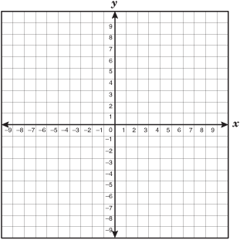
1 2 3 4 5 6
5, 8, 11, 14, 17, 20, . . .
x | y

Slide 2
Equation
Graph
Table
x | y

