Slide 1
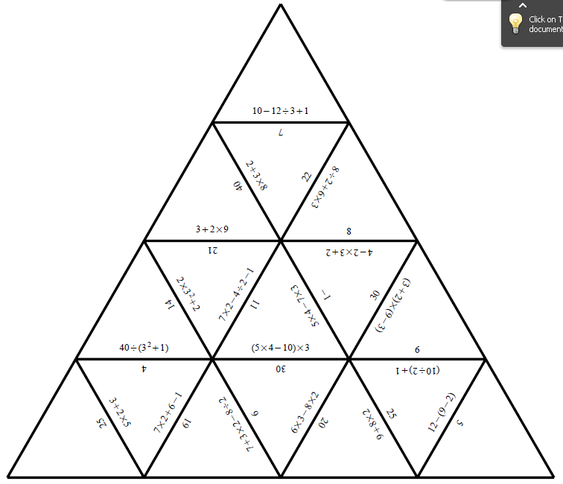
Find 5!
Using the correct order of operations Find 5 mistakes in this Jigsaw!

