Slide 1
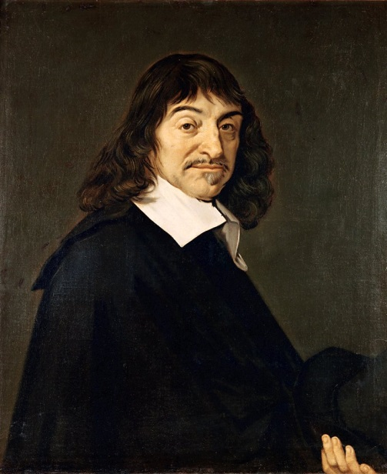
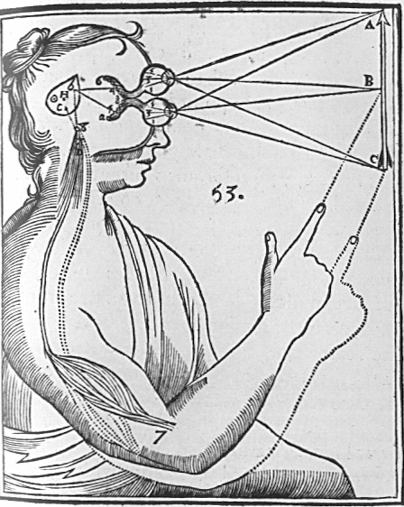
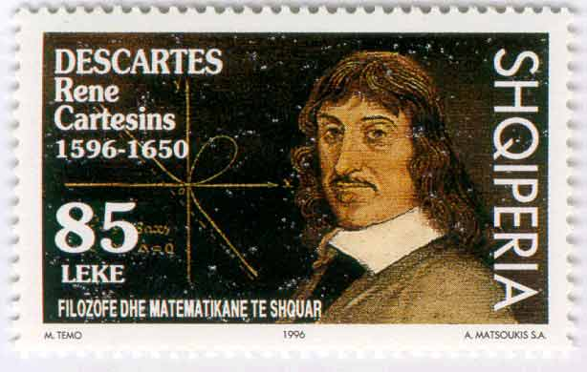
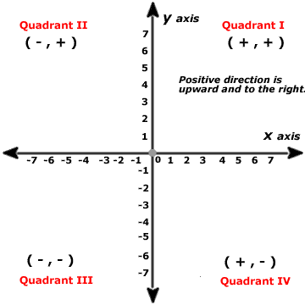
Geometrical Square Rooting

Slide 2
Starter
Calculate the following
i) √4 + √9
ii) √16 + √49
iii) √100 + √25 - √64
b) Tom uses his calculator to work out the square root of 80
His answer is 9.5
i) How do you know that something has gone wrong?
ii) Give a rough estimate of what his answer should be
5
11
7
9 x 9 is 81 which is already too high!
A bit less than 9!

Slide 3
Geometrical Square Rooting
Today we are going to look at how to approximate the square root of a number
Remember when square rooting an integer that isn’t a square number, the answer will be an irrational number, hence cannot be calculated exactly…
We will see how this can be done with only a ruler, compass and pencil!
This was discovered by René Descartes whilst having a lie in and staring at the ceiling…

Slide 4
Geometrical Square Rooting
René Descartes
→ Born on 15th March 1596
→ French Philosopher and Mathematician who spent most of his life in Holland
→ One of his greatest achievements was that he linked algebra and geometry by using graphs
→ This allowed mathematicians to show real world objects in terms of numbers
→ Graphs on a set of x and y axes are known as Cartesian graphs, after him
→ These days computer games use the same ideas, in that objects in games are plotted on a 3D coordinate grid
→ He rarely got up before Midday his whole life!
Now follow the instructions on the worksheet carefully! Accurate measuring is extremely important!

Slide 5
Geometrical Square Rooting
René Descartes
→ This method of square rooting was imagined by Descartes on his ceiling while having his daily lie in…
1) Draw a straight line of the length you wish to Square Root, eg) 9cm
2) Add 1 more unit to the length
3) Draw a Semi-Circle over the whole line, the centre will be half-way along…
4) Draw a Vertical Line up from where your original line ended
5) The length in this case is 3cm, the square root of 9. This works for any original starting number!
3cm
9cm
1cm

Slide 6
Geometrical Square Rooting
René Descartes
→ This method of square rooting was imagined by Descartes on his ceiling while having his daily lie in…
1) Draw a straight line of the length you wish to Square Root, eg) 12cm
2) Add 1 more unit to the length
3) Draw a Semi-Circle over the whole line, the centre will be half-way along…
4) Draw a Vertical Line up from where your original line ended
5) The length in this case is 3.46cm (to 2dp), the square root of 12. This works for any original starting number!
3.46cm
12cm
1cm
The only limitation of this is how accurately your ruler can measure the length…

Slide 7
Plenary
Diameter → x + 1
Why does this work?
1) Call the original length x
2) We then add 1…
3) And draw a semi-circle over the line
4) Then draw a line up from the end of the original line
5) Imagine there is a line from the centre of the semi circle, to the point where the Vertical line meets the edge…
6) We now have a right angled triangle. Lets label the sides…
7) Remember Pythagoras’ Theorem?
8) So the missing side is the square root of the original length, every time!
Radius → ¹/₂x + ¹/₂
Radius = half the diameter
¹/₂x + ¹/₂
c
b
a
x
¹/₂x - ¹/₂
1
Bottom Side = Radius - 1
Expand Brackets
Cancel Terms
Add ¹/₂x
Square Root

Slide 8
Summary
We have seen a method for square rooting by using geometry
We have seen that this method is actually a very clever use of Pythagoras’ Theorem!
We have also learnt about Rene Descartes, the founder of the Cartesian axes

