Slide 1
Smuggle
Get into groups of 4
Each player starts with £5000
Take it in turns to be the Customs Officer for one round (until all cards have been played)
The aim is to end up with the most money
The first player takes the top 4 cards, rolls the dice and then declares their goods.
Players pay the Customs Officer a duty on their declaration, based on the dice roll as below:
1=5%, 2=10%, 3=15%, 4=20%, 5=25%, 6=30%
If the Customs Officer believes the player, they take the duty and the cards are passed on to the next player. If the Customs Officer doesn’t believe the player they can challenge by saying ‘smuggle’, The player then reveals their cards. If they were lying they are fined £200 on top of the actual duty. If they were telling the truth they pay no duty at all and receive a £200 payoff for slander.
If the previous player was challenged, the next player takes 4 new cards from the deck. If not, they discard one card of their choice and take 1 from the deck.

Slide 2
Smuggle
Smuggle
Smuggle
Smuggle
Smuggle
Smuggle
Smuggle
Smuggle
Smuggle

Slide 3
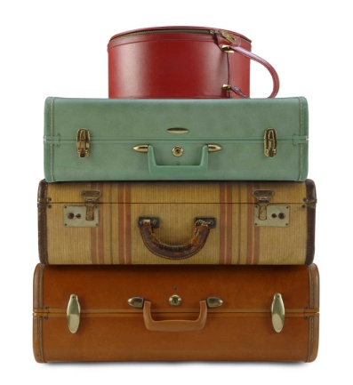
Luggage
Luggage
Luggage
Free!
Free!
Free!
Luggage
Luggage
Luggage
Free!
Free!
Free!
Luggage
Luggage
Luggage
Free!
Free!
Free!

Slide 4
Smuggle
Smuggle
Smuggle
Smuggle
Smuggle
Smuggle
Smuggle
Smuggle
Smuggle

Slide 5
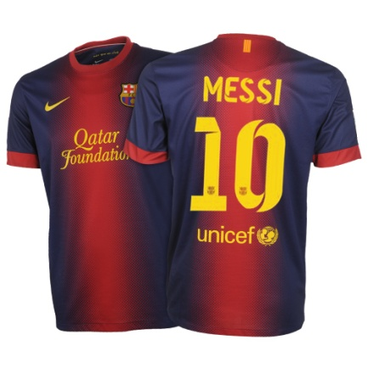
Football kit
Football kit
Football kit
£60
£60
£60
Football kit
Football kit
Football kit
£60
£60
£60
Smartphone
Smartphone
Smartphone
£200
£200
£200

Slide 6
Smuggle
Smuggle
Smuggle
Smuggle
Smuggle
Smuggle
Smuggle
Smuggle
Smuggle

Slide 7
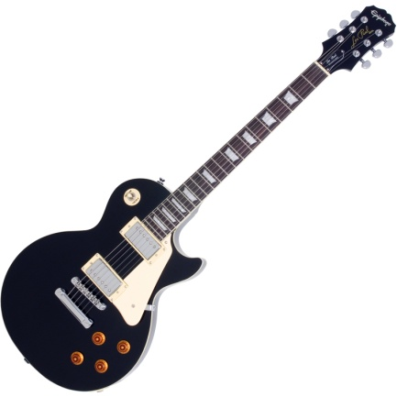
Smartphone
Smartphone
Electric guitar
£200
£200
£300
Electric guitar
Electric guitar
Electric guitar
£300
£300
£300
Games console
Games console
Mountain bike
£400
£400
£1000

Slide 8
Smuggle
Money
Each player starts with £5000
Accusations
Correct accusation = actual duty + £200 fine
False accusation = no duty + £200 damages
Duty rates
1=5%, 2=10%, 3=15%, 4=20%, 5=25%, 6=30%
Luggage
Football kit
Smartphone
Free!
£60
£200
Electric guitar
Games console
Mountain bike
£300
£400
£1000

